Slide 1

THE
ARUBA
PROJECT
By Dr. Richard Visser
Former Minister of Health and Sports of Aruba

Slide 2
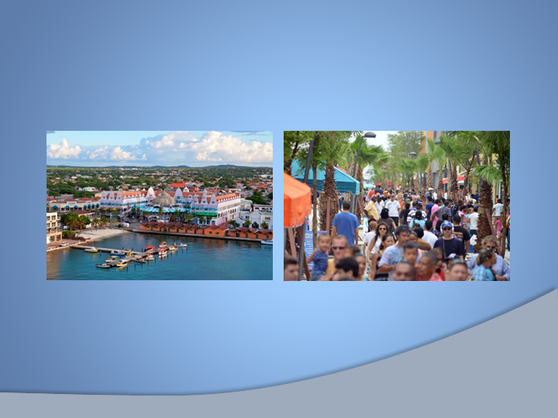
THE PARADIGM SHIFT

Slide 3
1.5 M Tourists a year mostly from the US basis of our economy
Everything we consume in any form has to be imported
GDP per capita U$25.300,-
Population 110.000 / 100 different nationalities.
Education is free
Universal Health Care in place

Slide 4
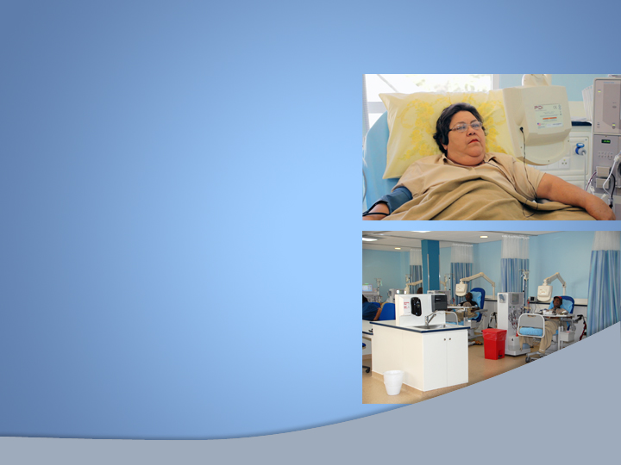
SO
WHAT’S
THE
PROBLEM?

Slide 5
Lack of Health information and vision by all stakeholders
Care Costs, NCDs, Obesity and. sedentary lifestyle, all skyrocketing past US numbers.
Obesogenic Environment.

Slide 6

2005 POPULATION STUDY
CHILDHOOD OBESITY
LIFESTYLE REVEALED
SHOCKING
RESULTS!

Slide 7
The Death Trap
Overweight 36% 41% 81%
Obese 25% 21% Higher
Sedentary 70% 50% 61%

Slide 8

THE ACCION STEPS
Creating Awareness

Slide 9

THE
NATIONAL PLAN
WITH STAKEHOLDER

Slide 10
Get The Buy in…
Government
Parliament
NGO and Private sector
International Authorities; WHO, PAHO, IOC, World Bank.

Slide 11
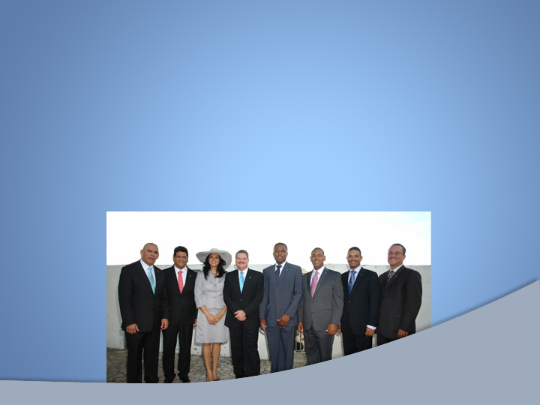
CREATE POLITICAL WILL…

Slide 12
Healthcare and Sports,
Education,
Social Affairs,
Law enforcement,
Infrastructure, Economy and Finance
link your projects to existing ones whenever possible to anchor them!

Slide 13
Establishing the Foundation
Baseline Populational Study
The National Plan
Create The Health Monitor
Create The Road Map
Modernize and update Health Legislation.
Implementation

Slide 14

CREATE A NEW
HEALTH AWARENESS INSTITUTE

Slide 15


Slide 16
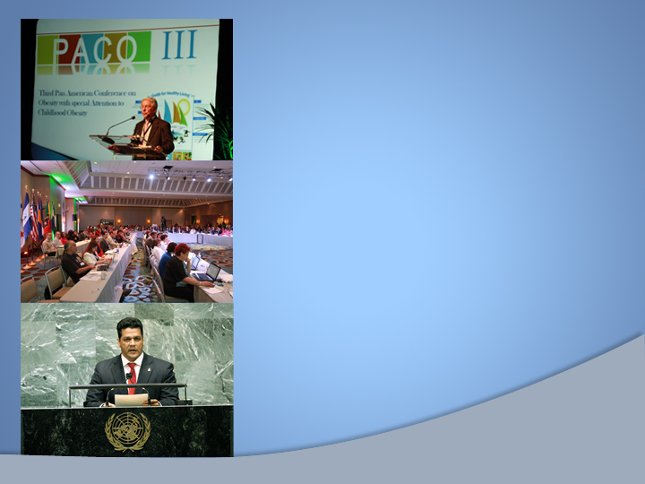
GO REGIONAL
AND
GLOBAL

Slide 17

International Partners, get their attention, have them help you with monitoring and evaluation PAHO / WHO / World Bank / IOC /
"PACO" created The Pan-American Conference for Obesity "the Aruba Call to Action" was included in the UN Millennium Goals

Slide 18
BE THE
EXAMPLE

Slide 19

RECOGNITION OF SPORTS

Slide 20
Getting to Critical Mass
2006 to 2013 300 % mass movement
2013/14 growth in numbers overweight and obesity stops and is showing signs of decline
Use of technology
e-Health, e-Patient files and the Health Bus.
A: Implement B: Monitor C: Evaluate: D: Adapt

Slide 21

TIMES OF INNOVATION AND TECHNOLOGY

Slide 22
We live in times of great innovation, with exponential technological development and never before seen global connectivity. This revolution is redefining every aspect of our lives, no matter our socioeconomic background and geographical location. We are converging these technologies to bring patients the future of healthcare.

Slide 23
THE
ARUBA
PROJECT
By Dr. Richard Visser
Former Minister of Health and Sports of Aruba

